Slide 1

HRA Employee Guide
2018
Company Name
This brochure is designed to give you only the highlights of your Plan with OCA. For a complete description of the terms and conditions, please refer to the Summary Plan Description/Plan Information Summary which is the legal document governing this plan.

Slide 2
Health Reimbursement Arrangement (HRA)
A Health Reimbursement Arrangement (HRA) is an employer funded arrangement that reimburses employees and dependents (if applicable) for certain healthcare expenses on a TAX FREE basis!
Helpful terms to remember…
Health Reimbursement Arrangement (HRA): Is a pre-tax reimbursement benefit that will reimburse you for certain out of pocket medical expenses. The HRA is funded by your employer!
Explanation of Benefits (EOB): An EOB is not a bill. It’s a statement sent by a health insurance company to covered individuals explaining what medical treatments and/or services were allowed by the insurance plan as well as identifying what the patient may owe to the doctor. Employees must submit the EOB to OCA in order to be reimbursed.
Claim Form: Employees must complete a HRA Claim form in order to be reimbursed. OCA’s claim form can be done either via paper, online, or via our mobile app.

Slide 3
How your HRA Benefit works…
  HRA will reimburse the following expenses:
    List Applicable Services Here
  The HRA will reimburse up to $X,XXX for single coverage and $X,XXX for employees with dependent coverage.
  The HRA plan runs calendar year (January 1 – December 31) and at the end of the plan year you have a run out period of 90 days. This will allow you to submit your current plan years’ claims beyond the deadline up through March 31st. Any claims received after this date are not eligible for reimbursement.

Slide 4
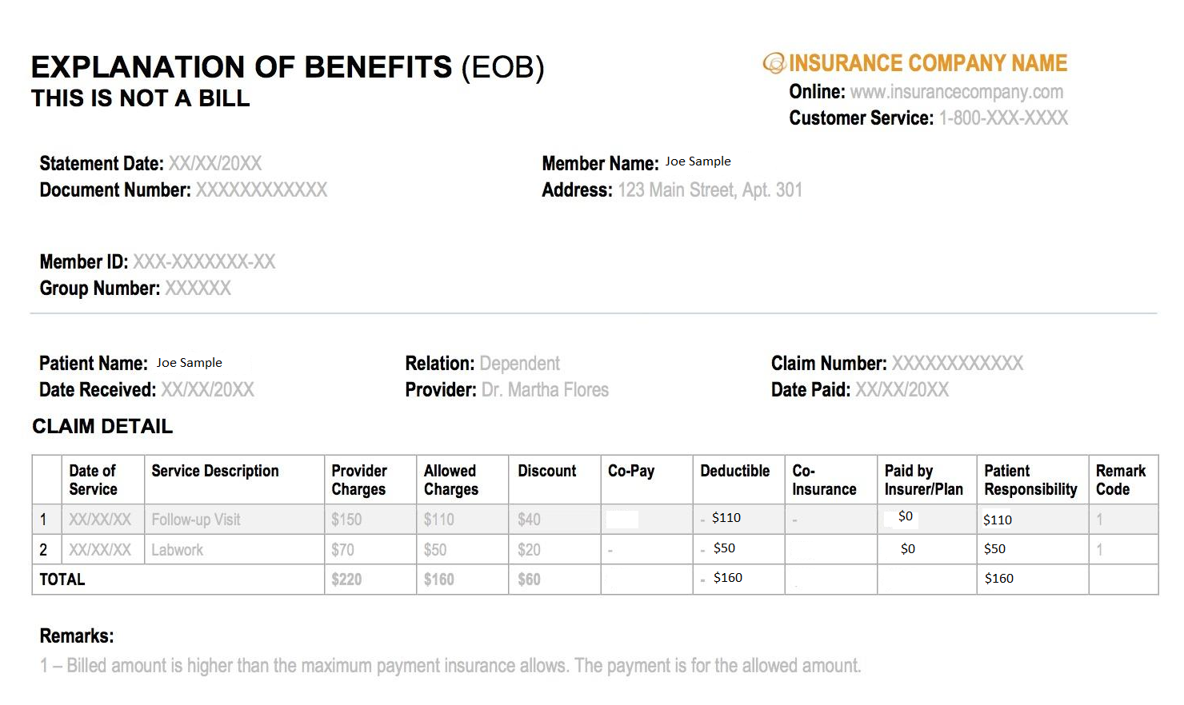
Sample Explanation of Benefits (EOB)

Slide 5
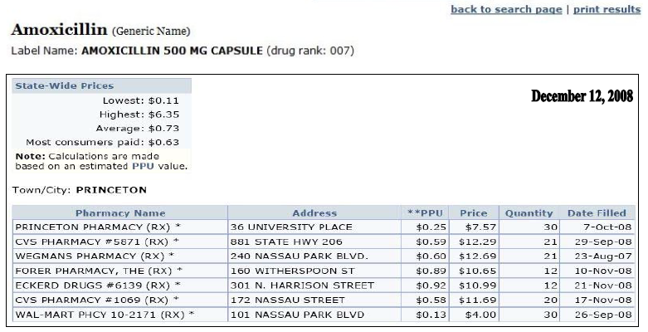
Finding the best drug prices…

Slide 6
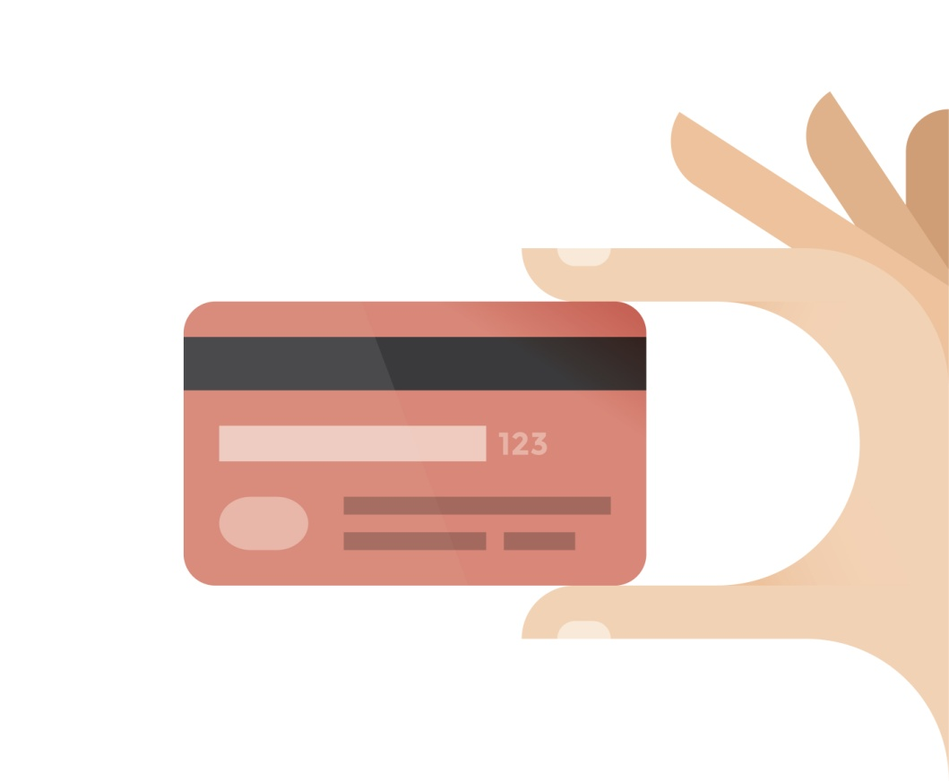
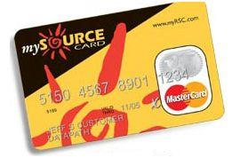
You’ll receive the mySource Debit Card
You will have a convenient mySource debit card to use for qualified healthcare expenses for you and your eligible dependents. The debit card is linked to your HRA program. You may also submit claims via our paper claim form, online claim form, or mobile app called myRSC.
IMPORTANT – SAVE YOUR RECEIPTS AND
EXPLANATION OF BENEFIT STATEMENTS (EOBs)
Federal regulations require that every FSA mySource transaction be substantiated in order to confirm that the transaction was for a qualified expense under the benefit plan.
Depending on which merchant, you may or may not be required to submit a claim form and EOB (or RX stub if it’s a prescription) to validate the swipe.
Watch for emails from OCA that will indicate if supporting documentation needs to be submitted.

Slide 7



How to submit a claim to OCA?
Paper Claim Form
Mail, fax, or email the copy of your Explanation of Benefits (EOB) with a completed OCA claim form. This can be mailed to 3705 Quakerbridge Rd, Suite 216, Mercerville, NJ 08619. It can also be faxed to 609-514-2778 or emailed to claims@oca125.com
Online Claim Form
Employees can file/submit claims directly through OCA’s secure portal, myRSC.
Mobile Claim Form
Employees can file/submit claims using OCA’s mobile app. It’s available in the iTunes Store and Google Play. Simply take a photo of the EOB and file your claim within seconds!

Slide 8
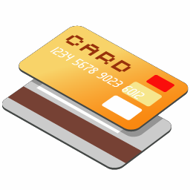
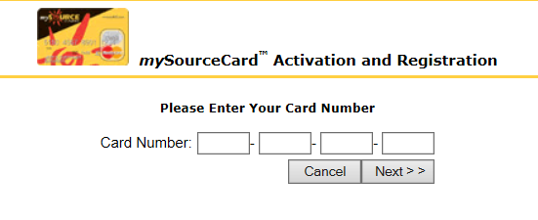


Create Your Online myRSC Account!
Step 1: Go to https://secure.myrsc.com and click the mySource picture.
Step 2: Enter in your mySourceCard number:
Step 3: Create a Username. The username must be a minimum of 6 characters, but never 9 characters in length.
Step 4: Create a Password. We recommend a password that uses a combination of letters and numbers, and is between 8 and 12 characters long. The only requirement is that your password is at least 4 characters in length and does not exceed 12 characters.

Slide 9
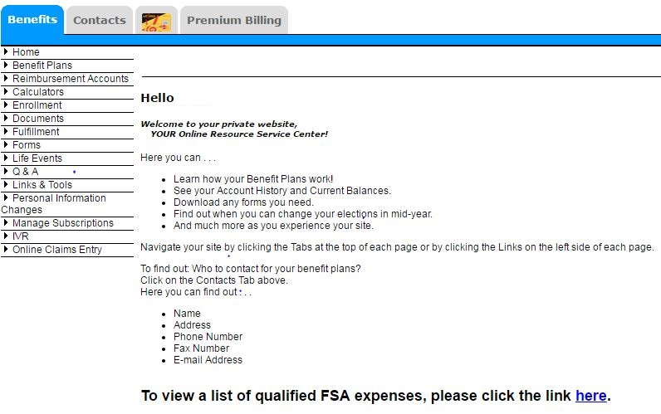
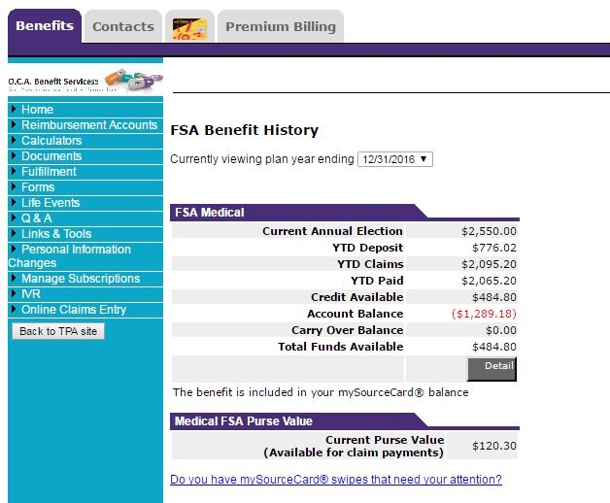
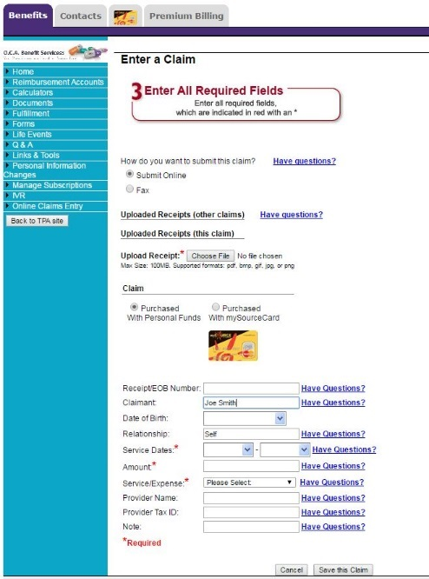
How to access your benefits online?
myRSC is O.C.A.’s online secure employee portal! Employees will be able to view there reimbursement history, review there mySourceCard activity, submit an online claim form, and more! To view your account history you’ll want to go to the orange square section below. To complete a claim form, go to the purple circle identified below.

Slide 10
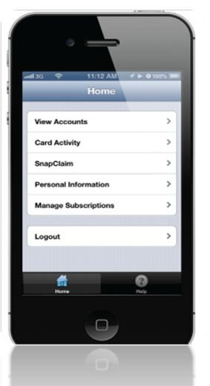
Mobile myRSC…
Logging In Open the Mobile myRSC® app or point your browser to: https://mobile.myrsc.com.
View Accounts
Including detailed account and balance information .
SnapClaim
File a claim and upload receipt photos directly from your Smartphone.
Debit Card Activity
View all debit card transactions and account activity.
Manage Subscriptions
Set up email notifications to keep you up-to-date on all account and health debit card activity.
Locating and Loading the Mobile myRSC App
Simply search for "myRSC" on the App StoreSM for Apple
products or on the Google Play™ Store for Android products,
and then load as you would any other app
Logging In
Use the same username and password you use to log in to the full myRSC website. After logging in, you will be on the home page which will list your options

Slide 11

Questions?
We should be contacted whenever questions arise regarding processing of claims, how to submit claims, how your benefit plan works or relate to your existing insurance plans, mySource debit cards, our web access portal (MyRSC), or just general knowledge/guidance questions.
OCAs Contact Information:
Phone Number: 609-514-0777 or Toll Free at 1-855-OCA-0777
Fax Number: 609-514-2778
Emails:
Service@oca125.com (Questions/Inquiries) – Any questions or inquirers regarding your claims history, card activity, balances, etc., please email OCA’s client service email.
claims@oca125.com (Claims Processing) – For participants choosing to email – rather than fax or use the online web portal or mobile app methods of remitting claims.

