Slide 1

FSA Employee Guide
2018
Company Name
This brochure is designed to give you only the highlights of your Plan with OCA. For a complete description of the terms and conditions, please refer to the Summary Plan Description/Plan Information Summary which is the legal document governing this plan.

Slide 2
What is a Flexible Spending Account
A Flexible Spending Account (FSA) is an IRS approved benefit that allows you to set aside money on a TAX-FREE basis to pay for unreimbursed healthcare expenses.
Healthcare FSA allows you to use pre-tax dollars for out-of-pocket medical, dental and vision expenses. FSA will usually include the deductible, coinsurance or copayment amounts for your health plan, eye glasses or contact lenses, dental work and orthodontia, medical equipment, hearing aids and chiropractic care. Be sure these expenses are not reimbursed thru another source.
Dependent Care FSA (DCA) covers employment-related expenses for child care. Typical expenses under this account include charges for day care, nursery school and elder care. The primary purpose cannot be for education.

Slide 3
Making FSA Contributions…
What are the maximum amounts that can be contributed each year to the Flexible Spending Plans?
Healthcare FSA annual limit is $2,650 (No annual minimum to participate)
Dependent Care FSA annual limit is $5,000 if married and filing a joint return or a single custodial parent. $2,500 if married filing a separate return. (No annual minimum to participate)
Your plan runs from January 1st through December 31st
Contributions are deducted in equal installments from your paycheck during the plan year. Deductions will be taken pre-tax and will reduce your FICA, State (NJ doesn’t allow for state tax deduction) and Federal income tax!

Slide 4
Use it or lose it and the $500 Rollover…
Your FSA runs calendar year. Any eligible purchases you make during the plan year are reimbursable. You will have 90 days from the plan end date to submit any claims that were incurred during the prior plan year. This is your run out period.
Your healthcare FSA allows you carry over up to $500 remaining at the end of a plan year, to be used for qualified medical expenses incurred in subsequent plan years. Any unused funds above $500 will be forfeited. This is due to the IRS “ use it or lose it” rule.
To participate, you simply need to complete the OCA enrollment form and determine your annual election. Once enrolled in the FSA, you and all of your tax dependents are automatically included.

Slide 5
Sample Eligible FSA Expenses
Acupuncture
Alcoholism treatment
Allergy shots and testing
Ambulance (ground or air)
Artificial limbs
Blind services and equipment
Car controls for handicapped*
Chiropractor services
Coinsurance and deductibles
Contact lenses
Crutches, wheelchairs, walkers
Deaf services -- hearing aid, etc.
Dental treatment
Dentures
Diagnostic tests
Drug addiction treatment & facilities
Drugs (prescription)
Eye examinations and eyeglasses
Home health and/or hospice care
Hospital services
Insulin
Laboratory fees
LASIK eye surgery
Medical alert (bracelet, necklace)
Medical monitoring and testing
Devices*
Nursing services
Obstetrical expenses
Operations and surgeries (legal)
Optometrists
Orthodontia
Orthopedic services
Osteopaths
Oxygen/oxygen equipment
Physical therapy
Psychiatric care, psychologists, psychotherapists
Radial keratotomy
Sexual dysfunction treatment
Smoking cessation
Surgical fees
Therapy treatments*
Vaccinations
Vitamins (prescription only)*
Weight loss programs*
X-rays
Effective January 1, 2011, OTC medications require a doctor’s prescription to be eligible for FSA/HSA reimbursement.
As a result, OTC medications cannot be purchased using the mySource card unless dispensed by a pharmacy the same as a standard prescription. If a manual claim is submitted for purchase on or after 1/1/11 of an OTC medication, a copy of the prescription and the purchase receipt must both be included with the claim in order to receive reimbursement.
Non-medicated OTC products (gauze pads, diabetes test strips, saline solution, etc.) are not affected by this change in the law. You can continue to receive FSA/HSA reimbursement for such items in the same manner you did prior to 1/1/11.

Slide 6
FSA Dependent Care (DCA)
You can use a Dependent Care Spending Account only if you pay dependent day care expenses to be able to work. Your day care services can take place either inside or outside of your home. If you are married, your spouse must also work, go to school full time, or be incapable of self-care for you to be eligible.
Only (a) dependents under the age of thirteen or (b) dependent adults or children thirteen years or older who are mentally or physically incapable of self-care are covered.
You cannot claim expenses if the service provider is your child or stepchild and are under age 19 or if you claim the service provider as a dependent for Federal income tax purposes.
To be reimbursed, you must include the facility’s name, address, and tax identification number or the Social Security number of the individual providing the dependent day care service.
Maximum Dependent Care Contribution Limit: $5,000 per year

Slide 7
Mid-Year Election Changes…
IMPORTANT: Participants enrolled in the FSA or DCA program cannot change their election during the plan year unless they have a qualifying life event.
A participant may change his or her pre-tax election(s) under certain Qualified Life Event conditions as outlined in your Summary Plan Description/Plan Information Summary, as well as in accordance with the I.R.S. consistency rules.
Only certain events would allow an individual to amend their election. Here are some events that may allow the participant to make a change: marriage, death of a spouse, divorce, legal separation or annulment, birth of a child, adoption or placement for adoption of a dependent, or death of a dependent.
Election changes must be made within 30 days of the event or during the annual election period by completing a Change of Status form.

Slide 8
Magic Formula
ESTIMATE ALL KNOWN EXPENSES FOR THE PLAN YEAR (Medical, Dental, Vision) |  | ESTIMATE ALL ANTICIPATED EXPENSES FOR THE PLAN YEAR
a) Health insurance deductibles | $_______ | $_______ $_______ $_______ $_______ $_______ $_______ $_______ $_______ $_______ $_______ $_______ $_______
b) Co-insurance (% not paid by insurance) | $_______
c) Vision care (eye exams, contacts, glasses) | $_______
d) Exams (OB-GYN, school physicals, etc) | $_______
e) Travel costs related to medical care | $_______
f) Prescription drugs | $_______
g) Medically required equipment | $_______
h) Wheelchairs, crutches, medical appliances | $_______
i) Dental exams, cleanings, x-rays, etc. | $_______
j) Braces, retainers, fillings, etc. | $_______
k) Orthodontics, implants, inlays, other | $_______
l) Other | $_______
TOTAL (A): | $_______ | TOTAL (B): | $_______
(Use 100% of this number) |  | (Use 50% of this number)

Slide 9
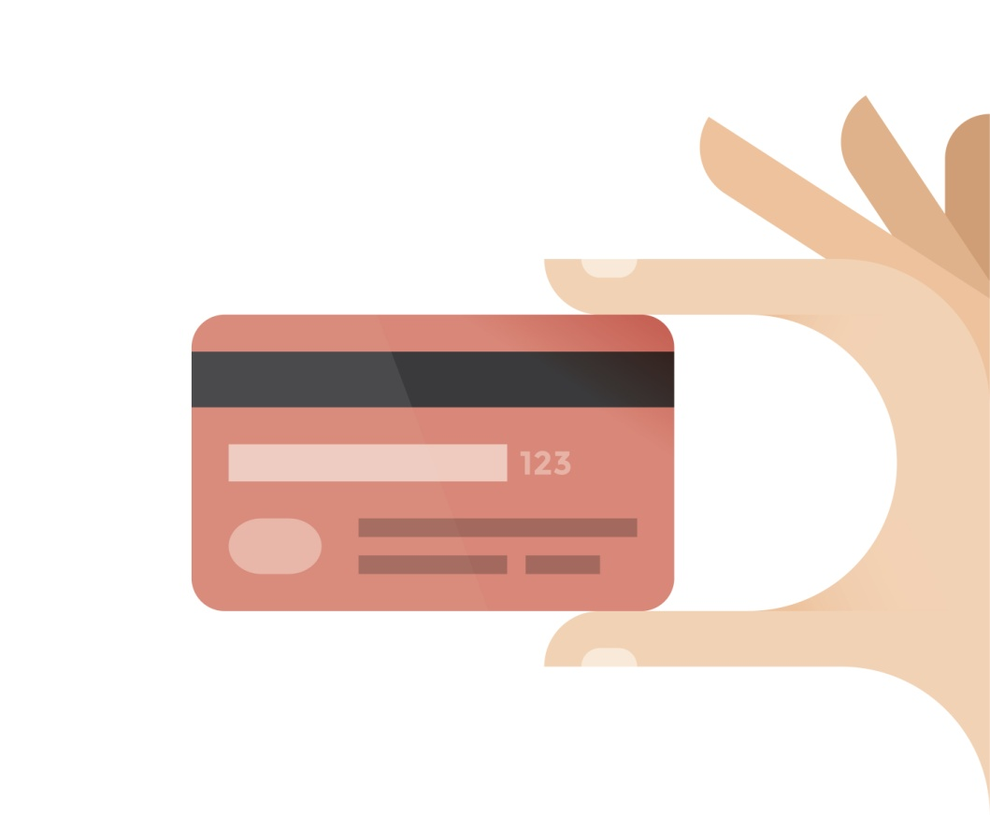
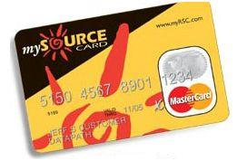
You’ll receive the mySource Debit Card
You will have a convenient mySource debit card to use for qualified healthcare expenses for you and your eligible dependents. The debit card is linked to your FSA program. You may also submit claims via our paper claim form, online claim form, or mobile app called myRSC.
IMPORTANT – SAVE YOUR RECEIPTS AND
EXPLANATION OF BENEFIT STATEMENTS (EOBs)
Federal regulations require that every FSA mySource transaction be substantiated in order to confirm that the transaction was for a qualified expense under the benefit plan.
Depending on which merchant, you may or may not be required to submit a claim form and EOB (or RX stub if it’s a prescription) to validate the swipe.
Watch for emails from OCA that will indicate if supporting documentation needs to be submitted.

Slide 10



How to submit a claim to OCA?
Paper Claim Form
Mail, fax, or email the copy of your Explanation of Benefits (EOB) with a completed OCA claim form. This can be mailed to 3705 Quakerbridge Rd, Suite 216, Mercerville, NJ 08619. It can also be faxed to 609-514-2778 or emailed to claims@oca125.com
Online Claim Form
Employees can file/submit claims directly through OCA’s secure portal, myRSC.
Mobile Claim Form
Employees can file/submit claims using OCA’s mobile app. It’s available in the iTunes Store and Google Play. Simply take a photo of the EOB and file your claim within seconds!

Slide 11

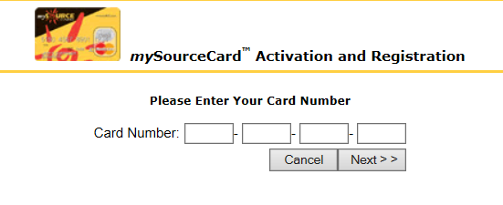


Create Your Online myRSC Account!
Step 1: Go to https://secure.myrsc.com and click the mySource picture.
Step 2: Enter in your mySourceCard number:
Step 3: Create a Username. The username must be a minimum of 6 characters, but never 9 characters in length.
Step 4: Create a Password. We recommend a password that uses a combination of letters and numbers, and is between 8 and 12 characters long. The only requirement is that your password is at least 4 characters in length and does not exceed 12 characters.

Slide 12
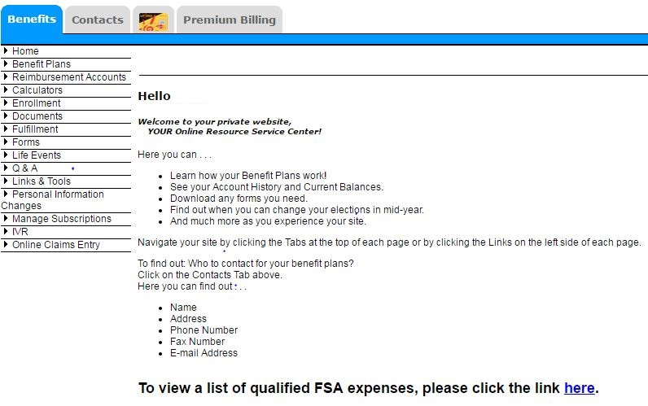
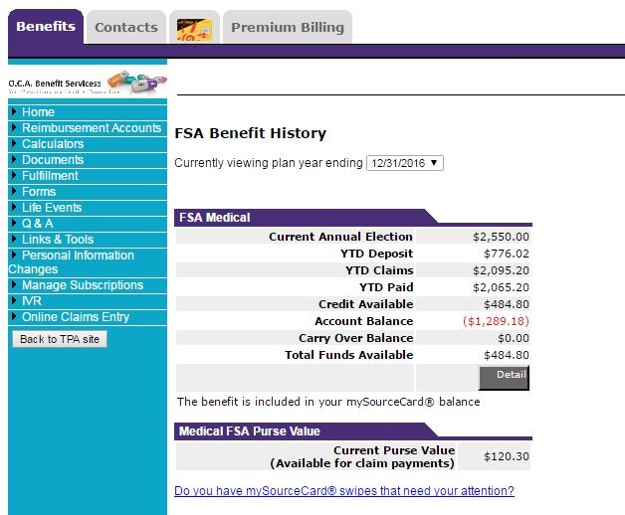
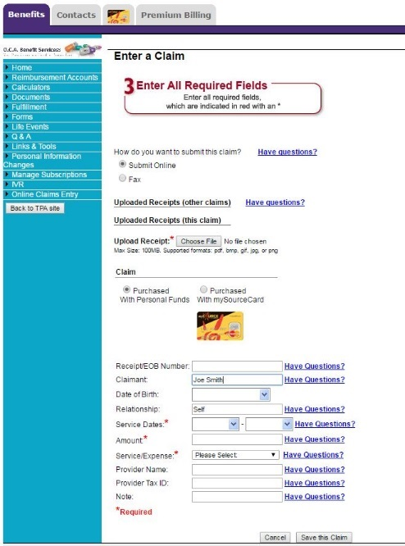
How to access your benefits online?
myRSC is O.C.A.’s online secure employee portal! Employees will be able to view there reimbursement history, review there mySourceCard activity, submit an online claim form, and more! To view your account history you’ll want to go to the orange square section below. To complete a claim form, go to the purple circle identified below.

Slide 13
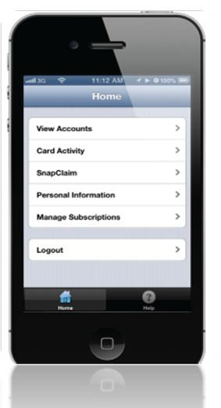
Mobile myRSC…
Logging In Open the Mobile myRSC® app or point your browser to: https://mobile.myrsc.com.
View Accounts
Including detailed account and balance information .
SnapClaim
File a claim and upload receipt photos directly from your Smartphone.
Debit Card Activity
View all debit card transactions and account activity.
Manage Subscriptions
Set up email notifications to keep you up-to-date on all account and health debit card activity.
Locating and Loading the Mobile myRSC App
Simply search for "myRSC" on the App StoreSM for Apple
products or on the Google Play™ Store for Android products,
and then load as you would any other app
Logging In
Use the same username and password you use to log in to the full myRSC website. After logging in, you will be on the home page which will list your options

Slide 14

Questions?
We should be contacted whenever questions arise regarding processing of claims, how to submit claims, how your benefit plan works or relate to your existing insurance plans, mySource debit cards, our web access portal (MyRSC), or just general knowledge/guidance questions.
OCAs Contact Information:
Phone Number: 609-514-0777 or Toll Free at 1-855-OCA-0777
Fax Number: 609-514-2778
Emails:
Service@oca125.com (Questions/Inquiries) – Any questions or inquirers regarding your claims history, card activity, balances, etc., please email OCA’s client service email.
claims@oca125.com (Claims Processing) – For participants choosing to email – rather than fax or use the online web portal or mobile app methods of remitting claims.

