Slide 1

Commuter Employee Guide
2018
Company Name
This brochure is designed to give you only the highlights of your Plan with OCA. For a complete description of the terms and conditions, please refer to the Summary Plan Description/Plan Information Summary which is the legal document governing this plan.

Slide 2
Commuter Benefits
A Commuter plan is an IRS approved benefit that allows you to set aside money on a TAX-FREE basis to pay for transportation and parking expenses to get to and from work!
Transit benefit allows you to use pre-tax dollars to pay for transportation expenses such as buses, rail, subway, ferry, shuttle bus, vanpool, and biking. For 2018, the maximum monthly pre-tax contribution is $260.
Parking benefit allows you to use pre-tax dollars to pay for parking (parking must be near office or at a near transit station) cost to get to and from work. For 2018, the maximum monthly election $260.
If enrolled in parking, employees may be reimbursed via paper check or direct deposit. This does not apply towards transit expenses. Important: Funds can only be reimbursed once the employee has contributed monies into their parking and/or transit benefit.

Slide 3

Expense Eligibility
For parking/vanpool expenses, you can only be reimbursed for expenses that were incurred getting to/from work. Transit doesn’t have to be exclusive.
What is eligible?
Buses, rail, subway, ferry, shuttle bus, vanpool, parking (parking must be near office or at a near transit station), and biking.
What is not eligible?
Carpool, telecommute, walk, taxis, tolls, fuel, and gas

Slide 4
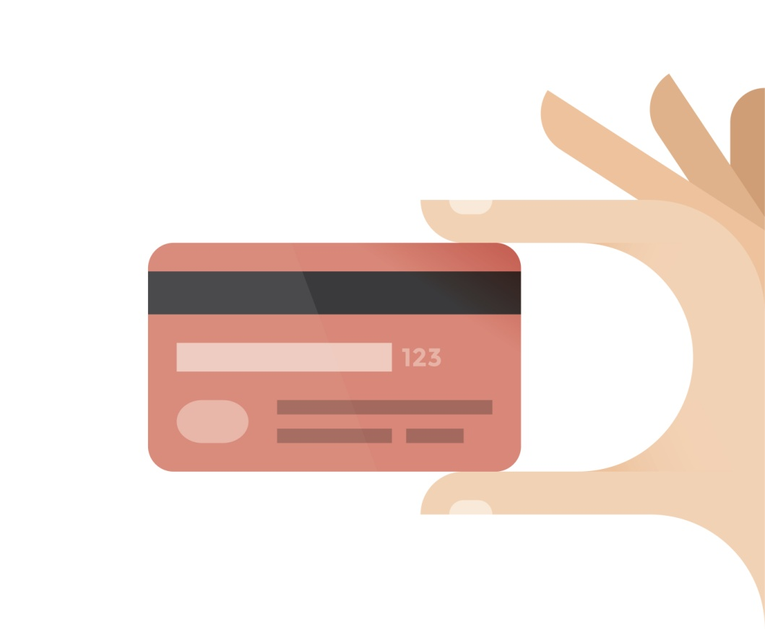
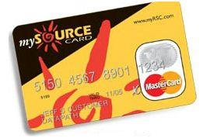
You’ll receive the mySource Debit Card
You will have a convenient mySource debit card to use for qualified healthcare expenses for you and your eligible dependents. The debit card is linked to your Commuter program. You may also submit claims via our paper claim form, online claim form, or mobile app called myRSC.
IMPORTANT – SAVE YOUR RECEIPTS AND
EXPLANATION OF BENEFIT STATEMENTS (EOBs)
Federal regulations require that every FSA mySource transaction be substantiated in order to confirm that the transaction was for a qualified expense under the benefit plan.
Depending on which merchant, you may or may not be required to submit a claim form and EOB (or RX stub if it’s a prescription) to validate the swipe.
Watch for emails from OCA that will indicate if supporting documentation needs to be submitted.

Slide 5



How to submit a claim to OCA?
Paper Claim Form
Mail, fax, or email the copy of your Explanation of Benefits (EOB) with a completed OCA claim form. This can be mailed to 3705 Quakerbridge Rd, Suite 216, Mercerville, NJ 08619. It can also be faxed to 609-514-2778 or emailed to claims@oca125.com
Online Claim Form
Employees can file/submit claims directly through OCA’s secure portal, myRSC.
Mobile Claim Form
Employees can file/submit claims using OCA’s mobile app. It’s available in the iTunes Store and Google Play. Simply take a photo of the EOB and file your claim within seconds!

Slide 6
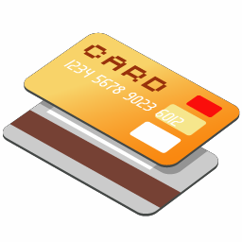
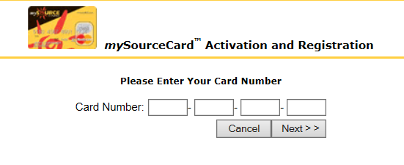


Create Your Online myRSC Account!
Step 1: Go to https://secure.myrsc.com and click the mySource picture.
Step 2: Enter in your mySourceCard number:
Step 3: Create a Username. The username must be a minimum of 6 characters, but never 9 characters in length.
Step 4: Create a Password. We recommend a password that uses a combination of letters and numbers, and is between 8 and 12 characters long. The only requirement is that your password is at least 4 characters in length and does not exceed 12 characters.

Slide 7
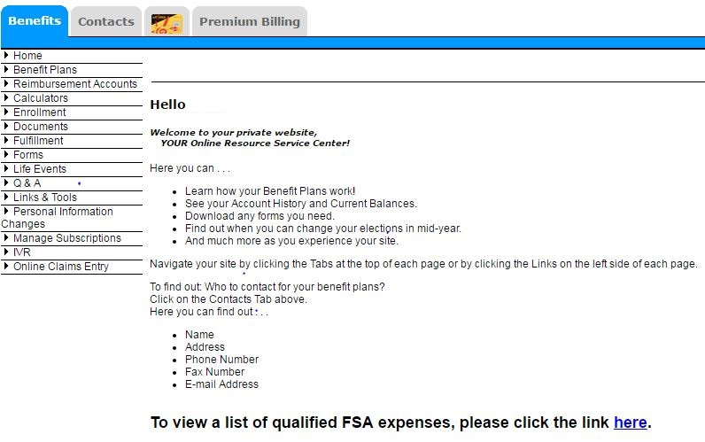
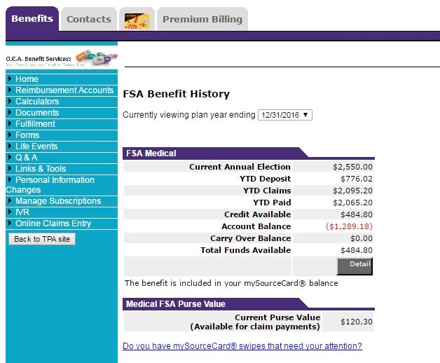
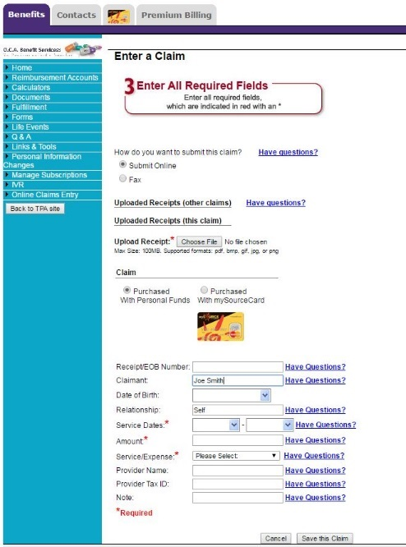
How to access your benefits online?
myRSC is O.C.A.’s online secure employee portal! Employees will be able to view there reimbursement history, review there mySourceCard activity, submit an online claim form, and more! To view your account history you’ll want to go to the orange square section below. To complete a claim form, go to the purple circle identified below.

Slide 8
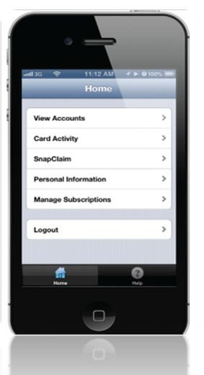
Mobile myRSC…
Logging In Open the Mobile myRSC® app or point your browser to: https://mobile.myrsc.com.
View Accounts
Including detailed account and balance information .
SnapClaim
File a claim and upload receipt photos directly from your Smartphone.
Debit Card Activity
View all debit card transactions and account activity.
Manage Subscriptions
Set up email notifications to keep you up-to-date on all account and health debit card activity.
Locating and Loading the Mobile myRSC App
Simply search for "myRSC" on the App StoreSM for Apple
products or on the Google Play™ Store for Android products,
and then load as you would any other app
Logging In
Use the same username and password you use to log in to the full myRSC website. After logging in, you will be on the home page which will list your options

Slide 9

Questions?
We should be contacted whenever questions arise regarding processing of claims, how to submit claims, how your benefit plan works or relate to your existing insurance plans, mySource debit cards, our web access portal (MyRSC), or just general knowledge/guidance questions.
OCAs Contact Information:
Phone Number: 609-514-0777 or Toll Free at 1-855-OCA-0777
Fax Number: 609-514-2778
Emails:
Service@oca125.com (Questions/Inquiries) – Any questions or inquirers regarding your claims history, card activity, balances, etc., please email OCA’s client service email.
claims@oca125.com (Claims Processing) – For participants choosing to email – rather than fax or use the online web portal or mobile app methods of remitting claims.

